Slide 1
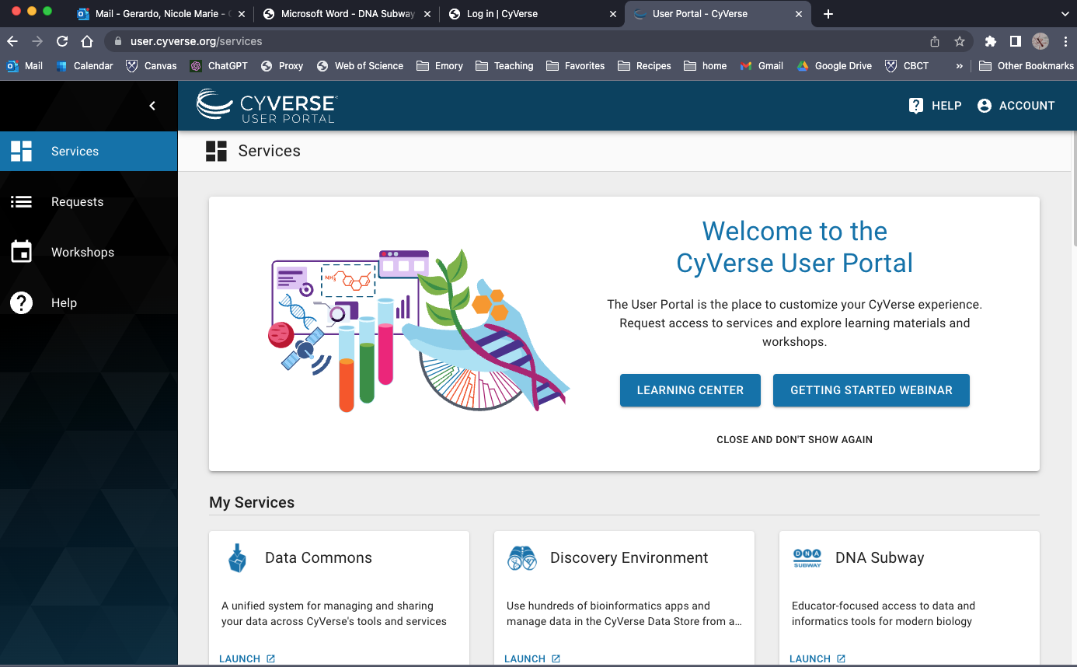
Set Up Cyverse Account

Slide 2
Set Up Cyverse Account
Go to https://user.cyverse.org/register. To avoid glitches, the Chrome browser is recommended.
Fill in the requested information to create your account. Make sure to use your primary work email address. Put this email in the chat, so we know what email you used to set up your account.
An email will be sent to your university address. This email will contain a link to confirm that the email address used was valid. Check your email and follow the steps contained in the email to confirm your address.
Once you confirm your email address, you will be directed to create a password for your new account.

Slide 3
Homework
Pick a bacterial colony from your culture plate to prepare and run PCR. Then, perform electrophoresis on the PCR products.
Read protocol on whole microbiome DNA extraction and view the video on this procedure.
Read the protocol on the community ecology analysis of colony-based sequences and view video on that analysis. Perform the community ecology analysis of the colony-based sequences (Sanger sequences) using the sample dataset: Demo Colony-Based Sequences Data bean host type (posted in Curriculum Materials)

Slide 4
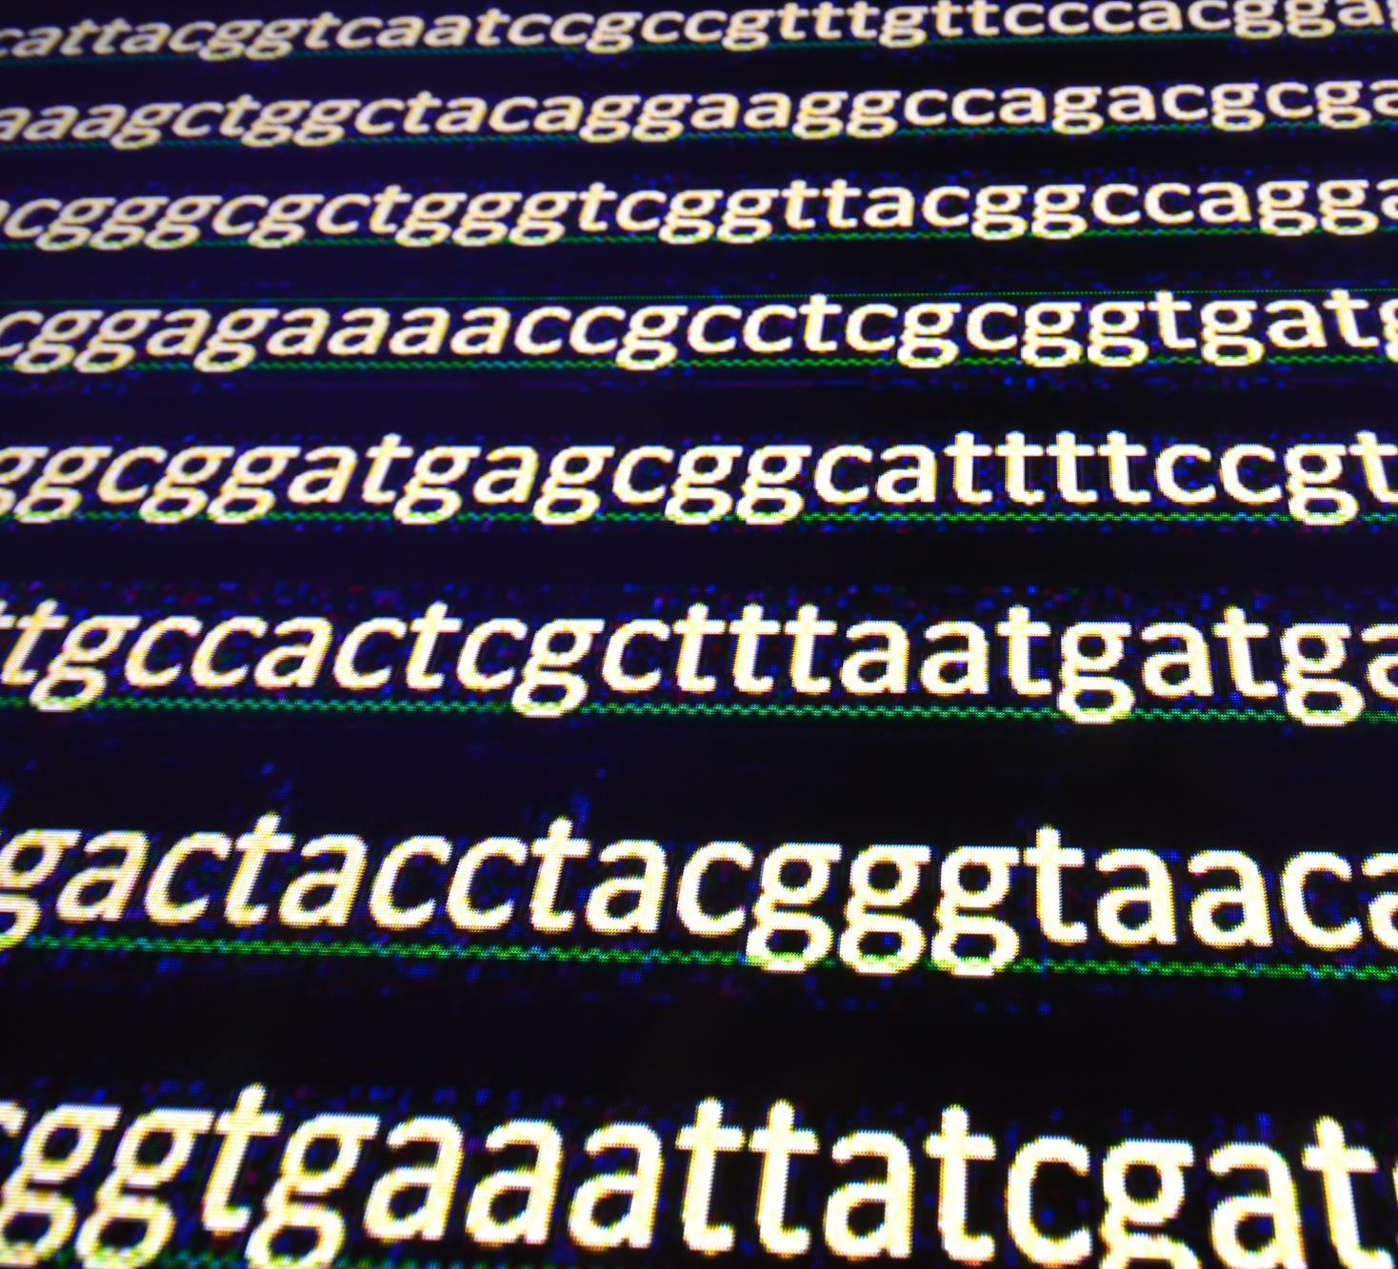
High Throughput Sequence Analysis

Slide 5
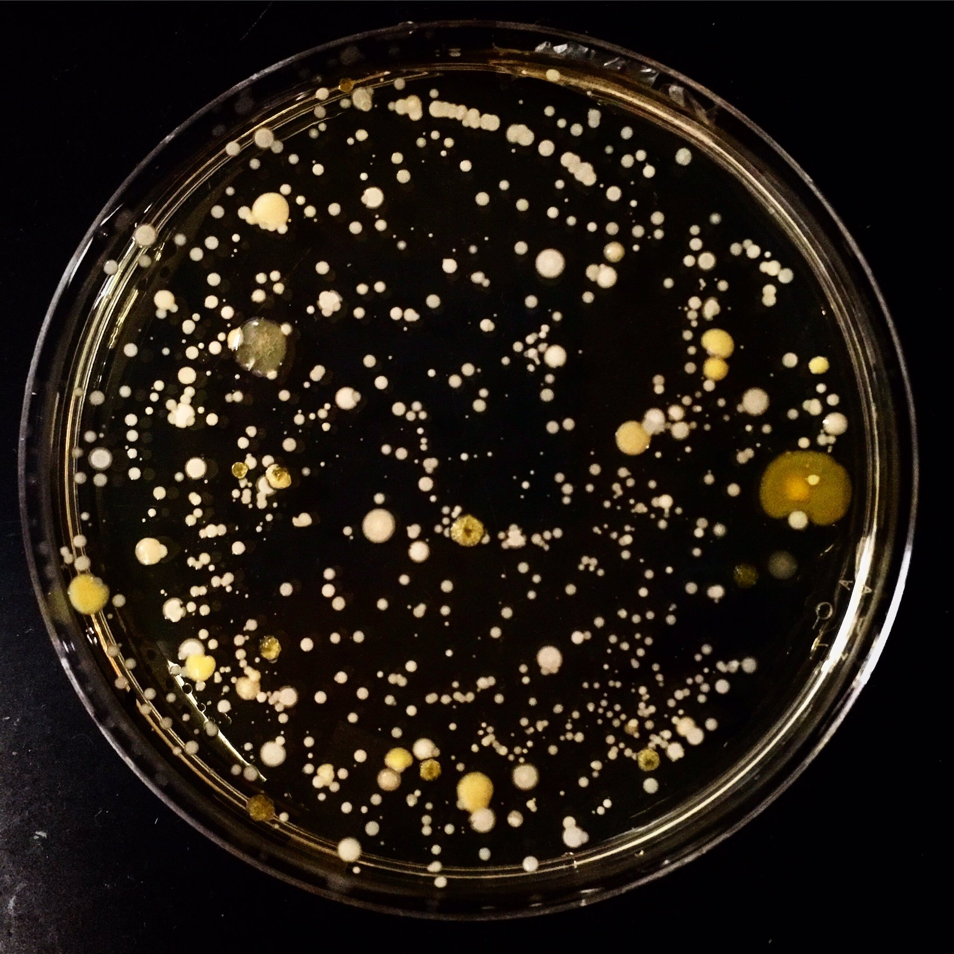
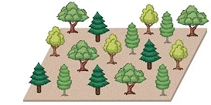
Relative number of different tree species
Relative number of different morphotypes
Relative number of different sequences

Slide 6
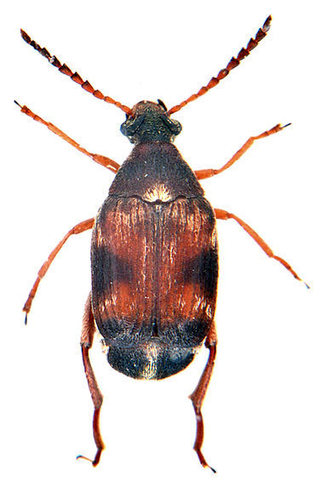
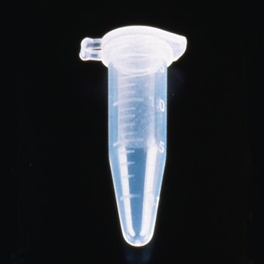
DNA
Extraction
Amplify bacterial gene,
Sequencing
Host and
its microbes
TOTAL DNA
(host and microbes)
Sequences of portion of
16s rRNA bacterial gene

Slide 7
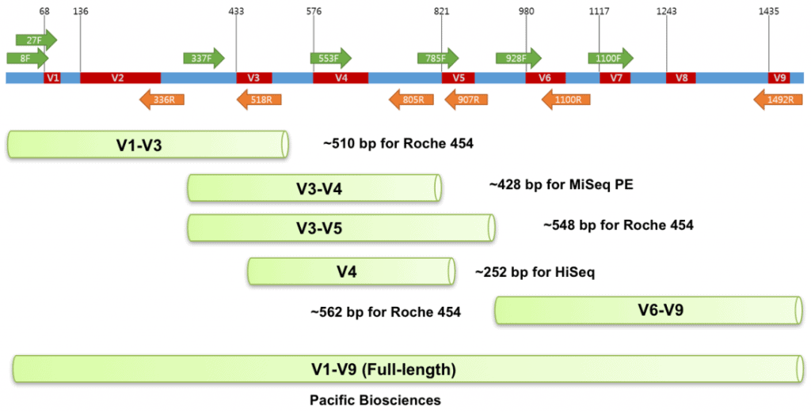
16s rRNA
https://help.ezbiocloud.net/16s-rrna-and-16s-rrna-gene/

Slide 8
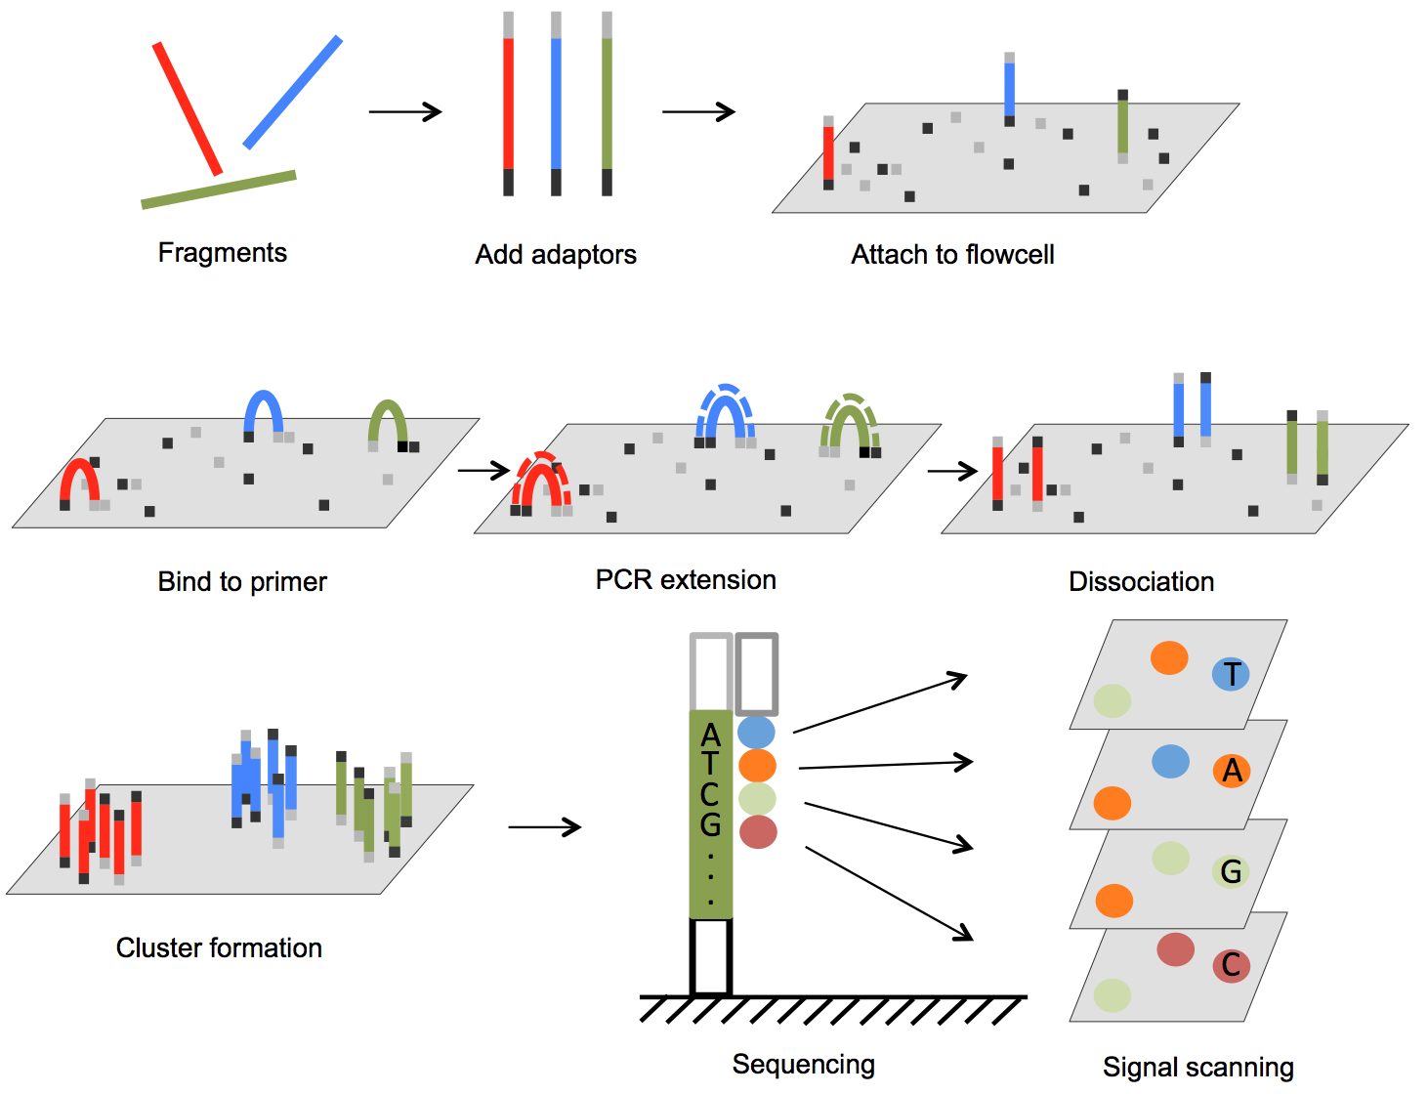
Illumina Sequencing
https://www.intechopen.com/chapters/49419

Slide 9
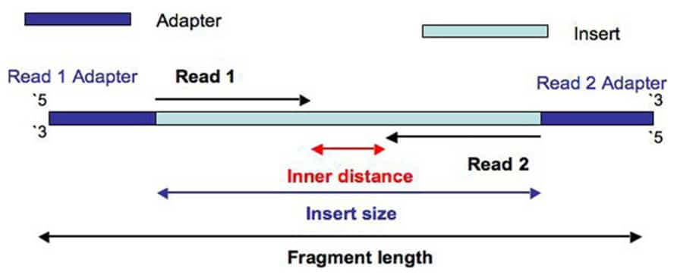
Paired End Sequencing
https://thesequencingcenter.com/knowledge-base/what-are-paired-end-reads/

Slide 10
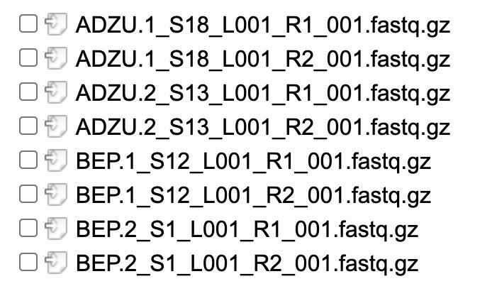
Paired End Sequencing

Slide 11
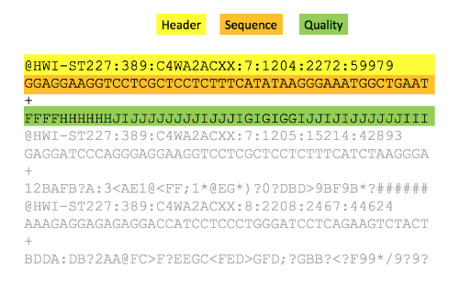
FastQ file

Slide 12
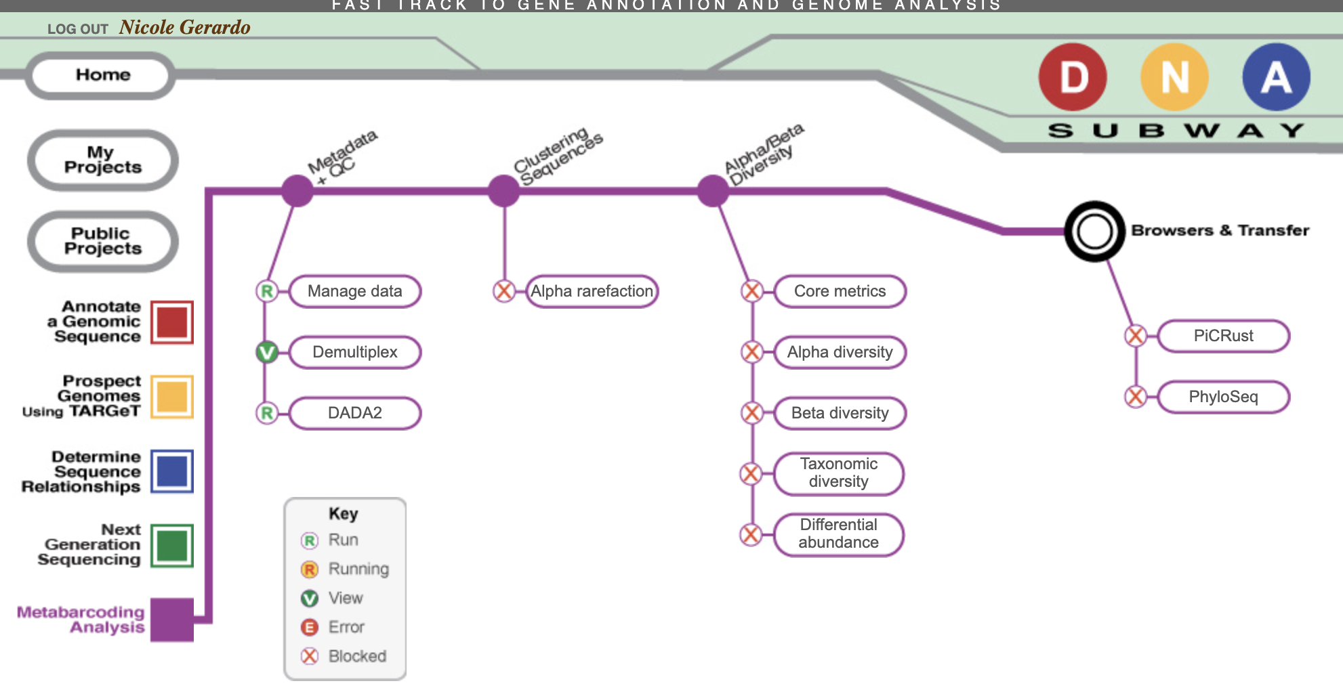

Slide 13
Demultiplexing:
Demultiplexing refers to the step in which you use the barcode information in order to know which sequences came from which samples. This step will also allow you to determine how many sequences you have for each sample.

Slide 14
DADA2
Removes low quality sequence, merges forward and reverse sequences, assigns sequences into clusters based on similarity

Slide 15
Alpha Rarefaction
Adjust for unequal sequencing across samples

Slide 16
Characterizing Diversity
This will cluster your sequence based on similarity and assign them to a bacterial taxon. You can look at some aspects of alpha diversity (within samples) and beta diversity (between samples) here, though you will have more more flexibility to do that later using a different tool.

Slide 17
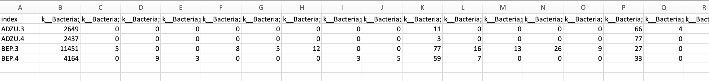
Level-5 Taxonomy Table
This is the file that can be downloaded after data processing in DNAsubway.

Slide 18
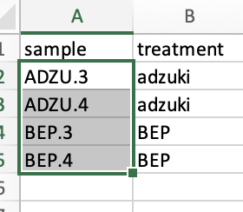
Metadata
You will need to create a simple file like this for your students. Or, you can have them make it.

Slide 19
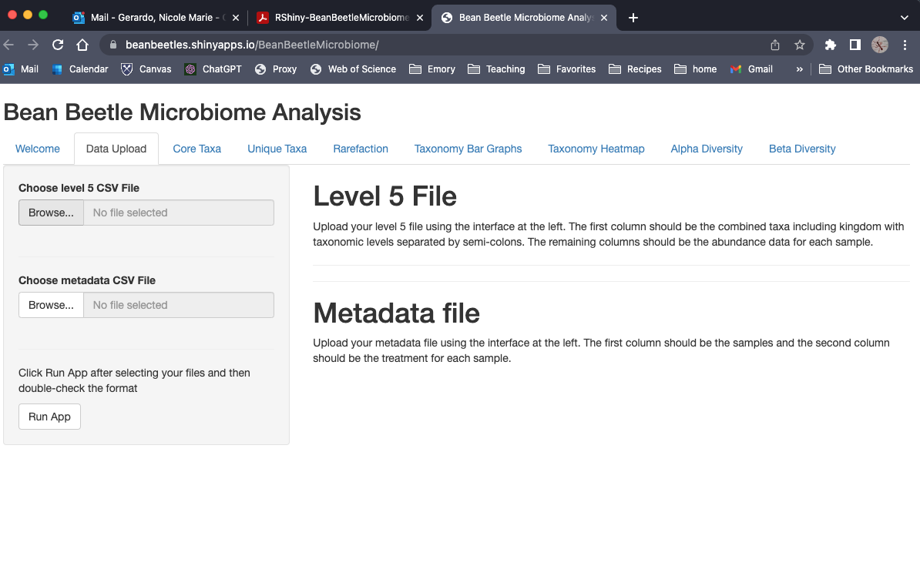

Slide 20
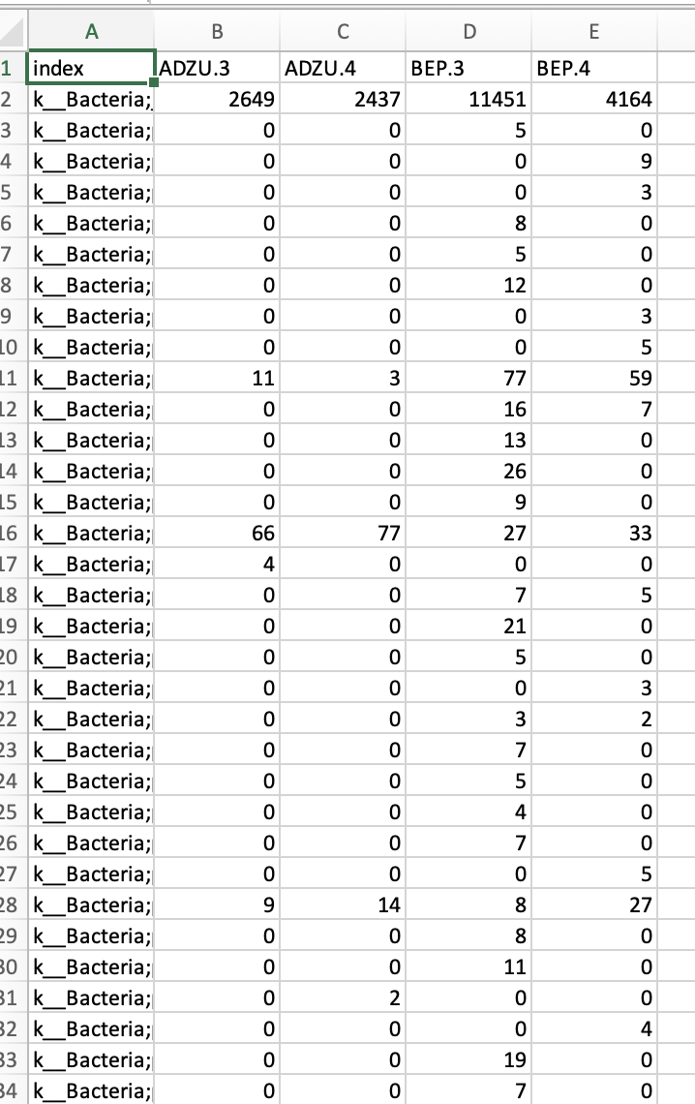
Transposed Level 5 File
Instructions of how to convert the Level-5 taxonomy table output from DNAsubway to this format is at beginning of the Rshiny App tutorial.

Slide 21
Homework
Complete the DNA Subway tutorial and download a Level-5 Taxonomy File in csv format from DNA Subway.
Read the RShiny BeanBeetleMicrobiome Tutorial and perform that analysis using the sample dataset. If you were unable to complete the DNA Subway analysis, you can download the files that you will need from the workshop schedule.
Discuss your implementation plans with your institutional partner and list the potential barriers you may have in your implementation. Each team should prepare one slide to present your implementation plan using template linked on workshop schedule.

Slide 22
Extra Material: Details of DADA2

Slide 23
DADA2
(Divisive Amplicon Denoising Algorithm)
Filter and Trim
Dereplicate
Calculate Error rates
Infer sample composition
Merge forward/reverse reads
Remove chimeras
Results in ASV’s (Amplicon Sequence Variants), not OTU’s

Slide 24
Filter and Trim
Filtering removes low quality sequences from the dataset
  Short sequences
  Sequences with too many low quality base pairs
Trimming trims the forward and reverse reads based on user parameters

Slide 25
Dereplication
The raw data has hundreds of thousands/millions of sequences. Many of them are exact replicas of each other.
Processing so many sequences is computationally intensive
Dereplication identifies and counts replicate sequences, then creates a new dataset with only 1 copy (or 1 representative sequence) along with with the count value of that sequence.

Slide 26
Estimation of Error Rates
Estimates error rates due to PCR amplification and sequencing
Algorithm uses mismatches between sequences and Q-scores to estimate sequences

Slide 27
Inference
Pairwise alignment
Uses error rates from previous step to determine sequence variation
Sequences with exact matches are grouped

Slide 28
Merge forward/reverse reads
Previous steps were done on forward and reverse reads separately
This step merges reads and throws out pairs that don’t match

Slide 29
Remove Chimeras
Chimeras can be formed during PCR amplification of mixed samples
Incompletely amplified sequences can act as a primer for another sequence, yielding a spurious amplicon
The chimeric sequence can then continue to be amplified in subsequent rounds of amplification

