Slide 1
Bean Beetle Microbiome Experimental Protocols 2
Tuesday 16 May 2023
Notes:
https://emory-my.sharepoint.com/personal/azelay2_emory_edu/_layouts/15/onedrive.aspx?csf=1&web=1&e=NdcgUi&CT=1621207348134&OR=OWA%2DNT&CID=67cfe59c%2Dc1b7%2D9b7c%2D3182%2D8779da1c3ec8&id=%2Fpersonal%2Fazelay2%5Femory%5Fedu%2FDocuments%2FSummer%202021%20Workshop%2FInstructor%20Notes&FolderCTID=0x012000B6ADBBD077C69F46B1C648F82C478B8E

Slide 2
1. Colony Phenotypes >>> ID different Taxa
Experimental Protocols:
2. Picked Colony, PCR, Sanger sequence >>> Taxa ID (Genus)
3. NextGen Sequence >>> Taxa ID (Family)
Taxa ID permits community comparisons

Slide 3
Week | Full Semester Implementation
1 | Introduction to insect microbiomes, bean beetles, experimental design, & culturing of microbes
2 | DNA extraction for microbial community sequencing
3 | Iteration day for unsuccessful DNA extractions
4 | Phenotypic assessment of microbes & culture-based PCR of selected colonies
5 | Electrophoresis and iteration day for unsuccessful culture-based PCR
6 | Introduction to bioinformatics & analysis of colony sequencing data
7 | Introduction to community analysis, phenotype & colony sequencing analysis
8 | Introduction to DNA Subway and analysis of microbial community sequencing data
9-11 | Bioinformatic analysis of microbial community sequencing data
12-13 | Community analysis of sequencing data
14 | Final presentations

Slide 4
Week | Half-Semester Implementation
1 | Introduction to insect microbiomes, bean beetles, experimental design, & culturing of microbes
2 | DNA extraction, phenotypic assessment of microbes, & culture-based PCR of selected colonies
3 | Electrophoresis and iteration day for unsuccessful culture-based PCR
4 | Introduction to bioinformatics & analysis of colony sequencing data
5 | Introduction to community analysis, phenotype & colony sequencing analysis
6 | Community analysis of sequence data
7 | Final presentations

Slide 5
1. Colony Phenotypes >>> ID different Taxa
Experimental Protocols:
2. Picked Colony, PCR, Sanger sequence >>> Taxa ID (Genus)
3. NextGen Sequence >>> Taxa ID (Family)

Slide 6
Does diet influence the bean beetle gut-microbiome?
Beans produce different secondary metabolites
Adzuki beans contains higher levels than Blackeye peas (BEP)
Do secondary metabolites cause differences between the gut microbiomes of bean beetles from different host beans?

Slide 7
Experimental Design
Compare the bacterial microbiome of adult beetles from two host beans
Adzuki beans
Blackeye peas
Culture Microbiome Bacteria
Tabulate Phenotypes
Community Ecology Methods

Slide 8
Culturing Bean Beetle Gut Microbiome for Colony Phenotype Analysis
Surface Sterilization
Crush to release gut bacteria
Culture on solid media
10% Bleach (3s)
Water (10s)
70% Ethanol (5s)
Water (10s)

Slide 9
Colony Phenotypic Traits
Color: W (white), OW (off-white), R (red), OR (orange), Y (yellow)
Gloss: S (shiny), M (matte)
Form
Elevation

Slide 10
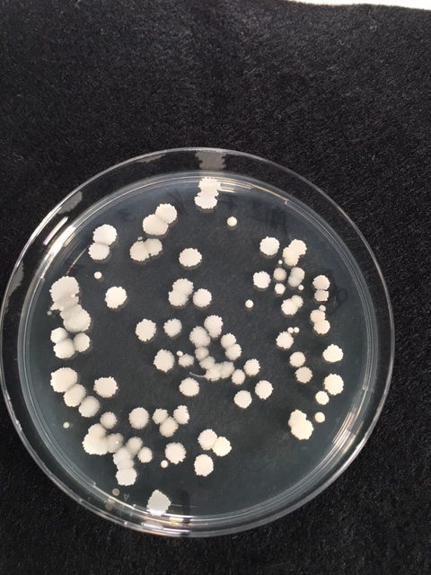
Color: W (white), OW (off-white), R (red), OR (orange), Y (yellow)
Gloss: S (shiny), M (matte)
Form
Elevation
 |  | Beetle Information |  | Colony Information
Treatment | Source | Host | Sex | Media | Color | Gloss | Form | Elevation | CFU Count
PEA 0.1x Female 1 Adzuki

Slide 11
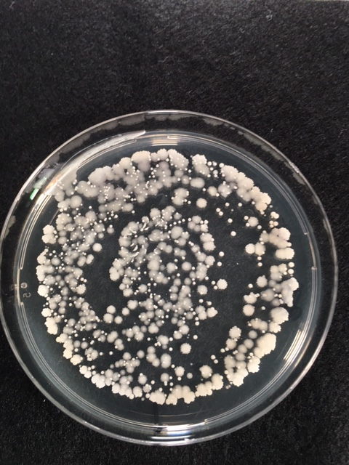
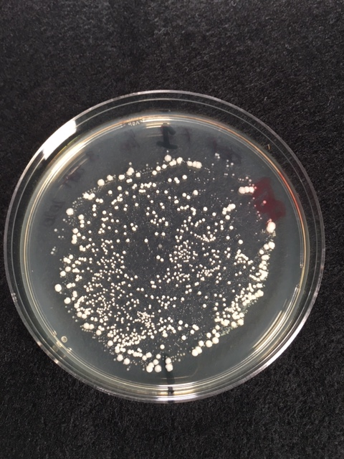
PEA 0.1x Female 5 from ADZ
PEA 0.1x Female 1 from BEP

Slide 12
Homework Tuesday 16 May
Prepare microbiome extracts and plate on nutrient agar (beetle(s) and negative control)​
​
Read protocols on community ecology analysis with colony phenotypes and perform analysis on Sample Data: ​Colony Phenotype Data (website>Microbiome>Curriculum Materials)
​
Read protocols and watch videos on:​ PCR, Sanger sequencing, and BLASTn

