Slide 1
Bean Beetles as a Model System
Bean Beetle Microbiome Project
2023 Workshop

Slide 2
Resources for Faculty at www.beanbeetles.org
Bean Beetle Handbook
Tested Laboratory Protocols
“Bibliography”
Microbiome Protocols
Student Handouts and Instructor Notes
Video clips on protocols
Microbiome Databases and Sample Datasets

Slide 3
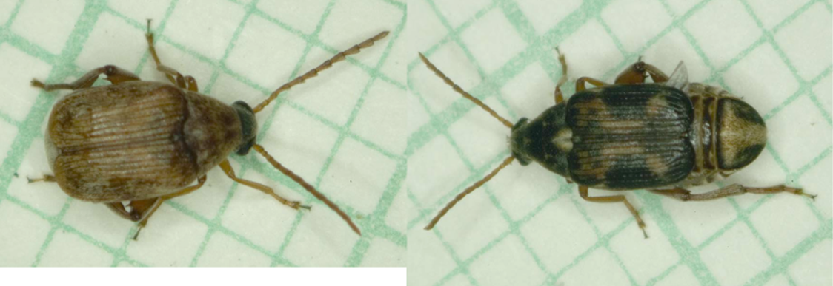
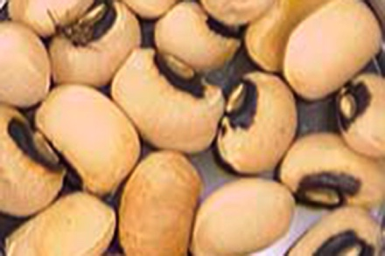
Bean Beetles
Callosobruchus maculatus
Tropical species
Temperate zone invasion

Slide 4
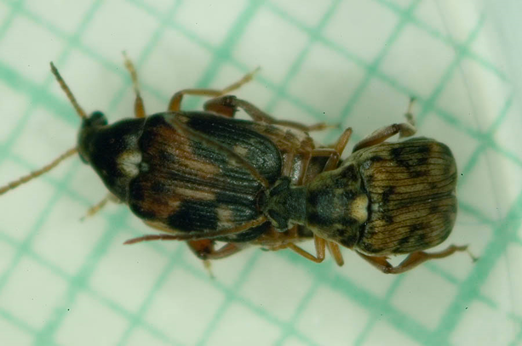
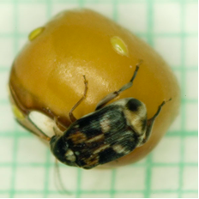
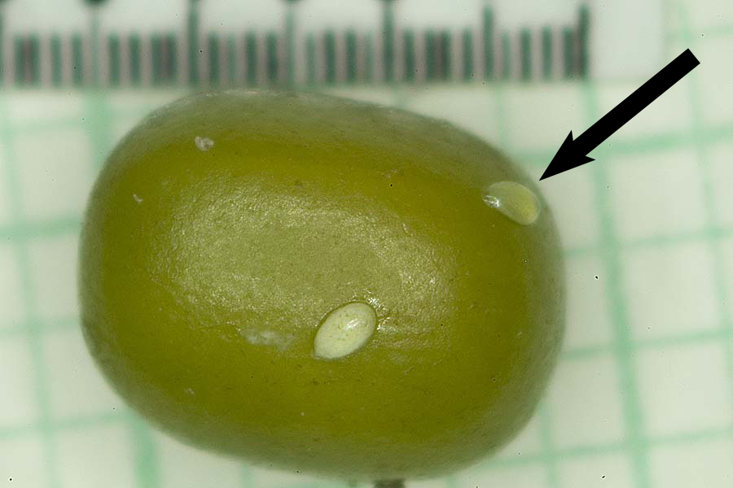
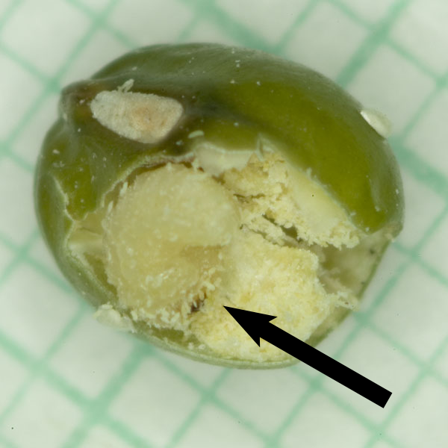
Bean Beetle Life Cycle

Slide 5
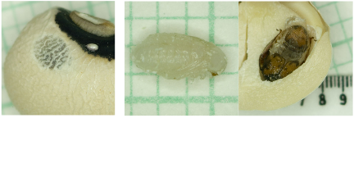
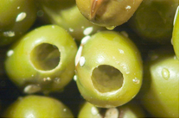
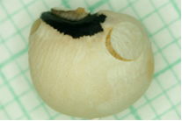

Slide 6
Bean beetles get all their nutrition from the host bean.
Adult bean beetles do not feed.

Slide 7
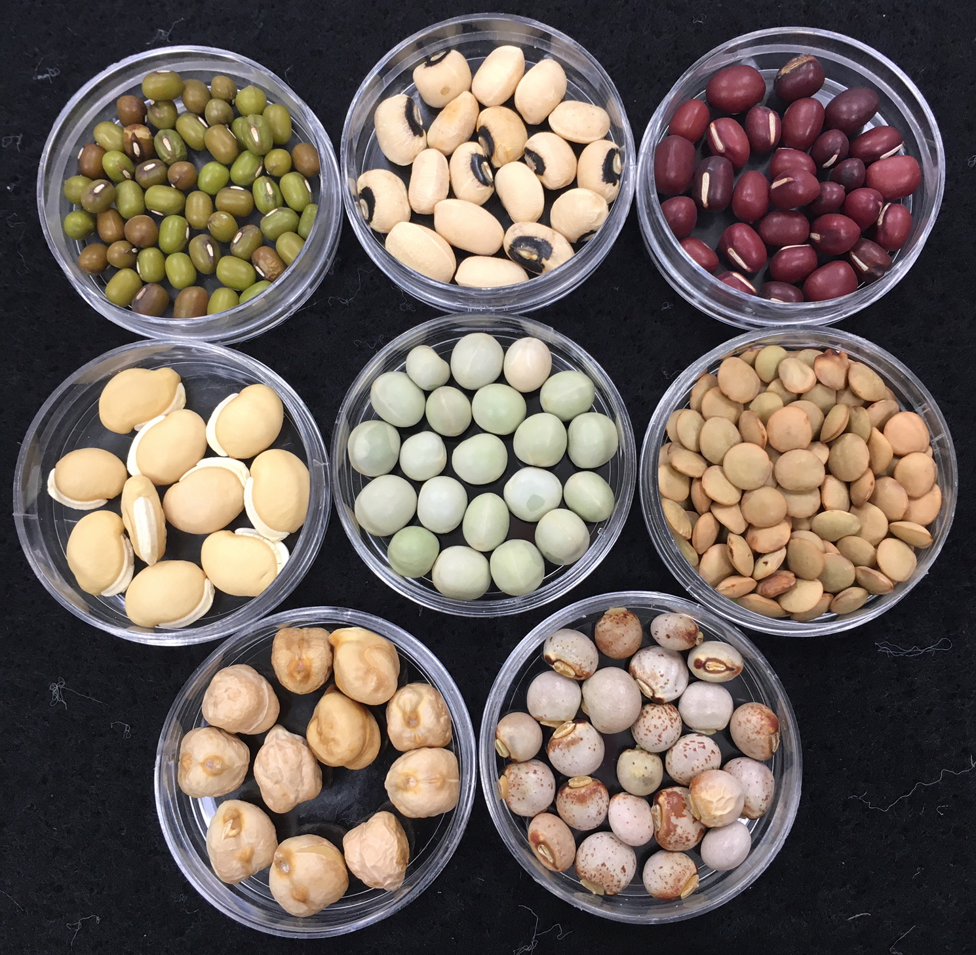
Dried beans:
Blackeye peas
Mung bean
Adzuki bean
Pigeon peas
Hyacinth bean
Chickpeas
Green peas
Lentils
Culture Methods

Slide 8
Life cycle (egg to adult emergence) time 3-5 weeks depending on host and temperature.
RH influences development success rate.

Slide 9
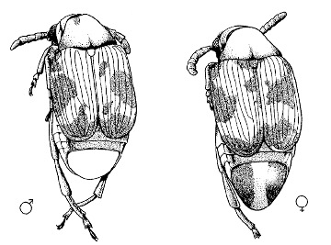
Sex Identification

Slide 10
Containment and Disposal
Bean beetles are agricultural pests
Do not release to environment
Do let let students take culture out of laboratory containment
Disposal
Freeze at -20°C for 72 hours (3 days)
double bag
dispose as food waste

Slide 11
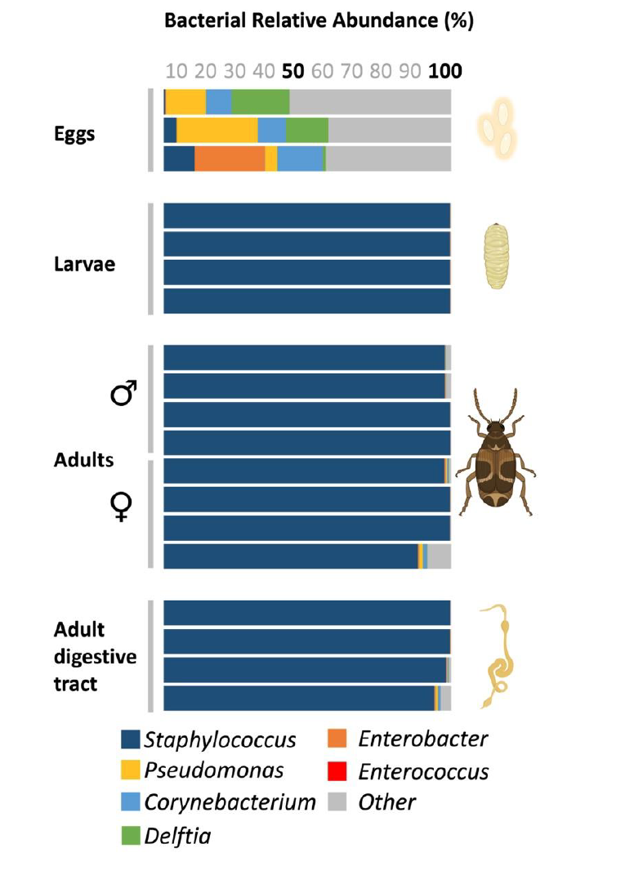
The Bean Beetle Microbiome

Slide 12
The Bean Beetle Microbiome

Slide 13
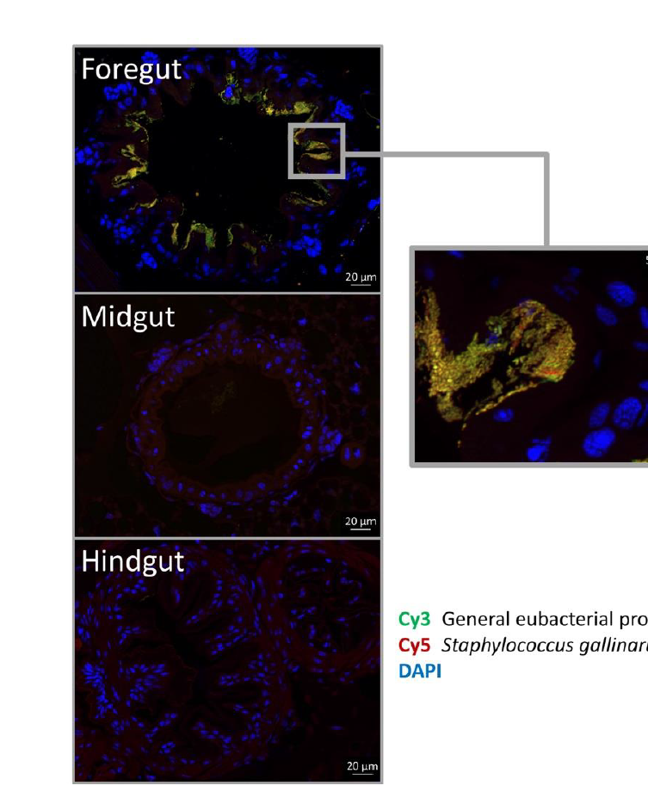
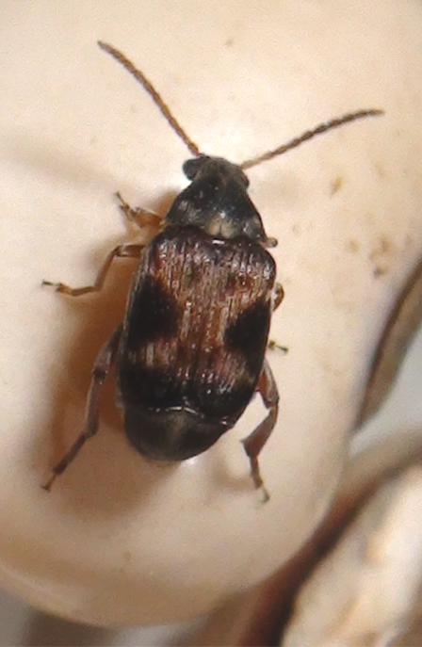
The Bean Beetle Microbiome
DNA:
Beetle
Staph-Specific
Most Bacteria

