Slide 1
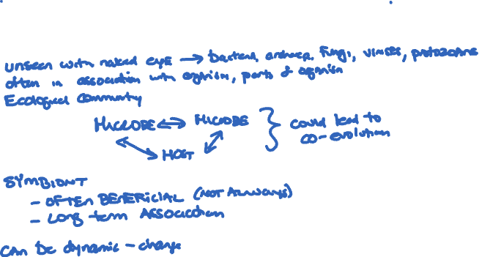
What is a Microbiome?

Slide 2
Which best represents the cellular composition of a human body?
Fungal
Bacterial
Human
A
B
C

Slide 3
Which best represents the cellular composition of a human body?
Fungal
Bacterial
Human
A
B
C

Slide 4

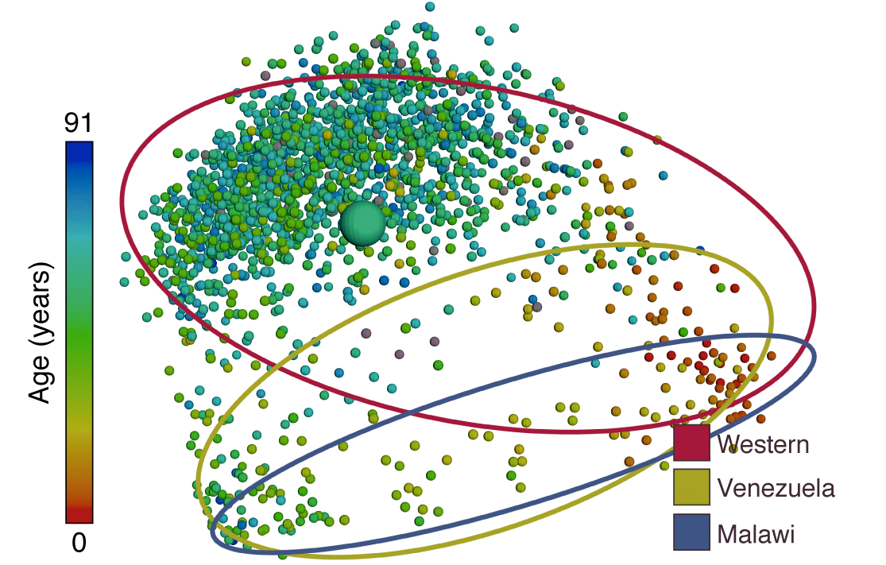
Every human is associated with a unique set of bacteria.
Me!
Notes:
While we don’t know what a lot of the bacterial species in your body are doing, we do know that each human is associated with a unique set of bacteria.
Here, we see a plot from the American Gut project. For this project, volunteers send a fecal sample from which their bacterial microbiota of their gut is characterized. Here, two points on the graph that are close together indicate two volunteers that have similar gut microbiota. Two points that are farther apart represent volunteers whose gut microbiomes are more different. Overall, individuals of similar ages tend to have more similar gut microbes. We can see this by the fact that most infants (the red dots) are on the right, while most senior citizens (blue dots) are on the left.
We can also see an impact of where you live. Here, there are data from people living in the west (mainly the United States), in Venezuela and in Malawi. The ovals show where individuals from each of those regions are on the graph. The ovals don’t completely overlap, particularly as people get older. This may in part be driven by differences in diet between the three regions.
References:
McDonald, D., Hyde, E., Debelius, J. W., Morton, J. T., Gonzalez, A., Ackermann, G., et al. (2018). American Gut: an Open Platform for Citizen Science Microbiome Research. mSystems 3, 1–28. doi:10.1128/mSystems.00031-18.
http://humanfoodproject.com/americangut/

Slide 5
Each part of your body is associated with a unique set of bacteria.
Koren et al . 2013. PLoS Computational Biology
Notes:
Each part of your body is also associated with a unique set of bacteria.
References:
Koren, O., Knights, D., Gonzalez, A., Waldron, L., Segata, N., Knight, R., et al. (2013). A guide to enterotypes across the human body: meta-analysis of microbial community structures in human microbiome datasets. PLoS Comput. Biol. 9. doi:10.1371/journal.pcbi.1002863.
Turnbaugh, P. J., Ley, R. E., Hamady, M., Fraser-Liggett, C. M., Knight, R., and Gordon, J. I. (2007). The Human Microbiome Project. Nature 449, 804–810. doi:10.1038/nature06244.
The Human Microbiome Consortium (2012). Structure, function and diversity of the healthy human microbiome. Nature 486, 207–214. doi:10.1038/nature11234.

Slide 6
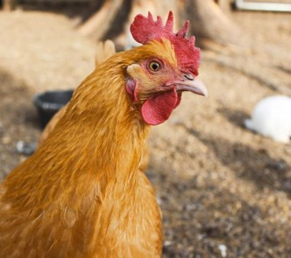

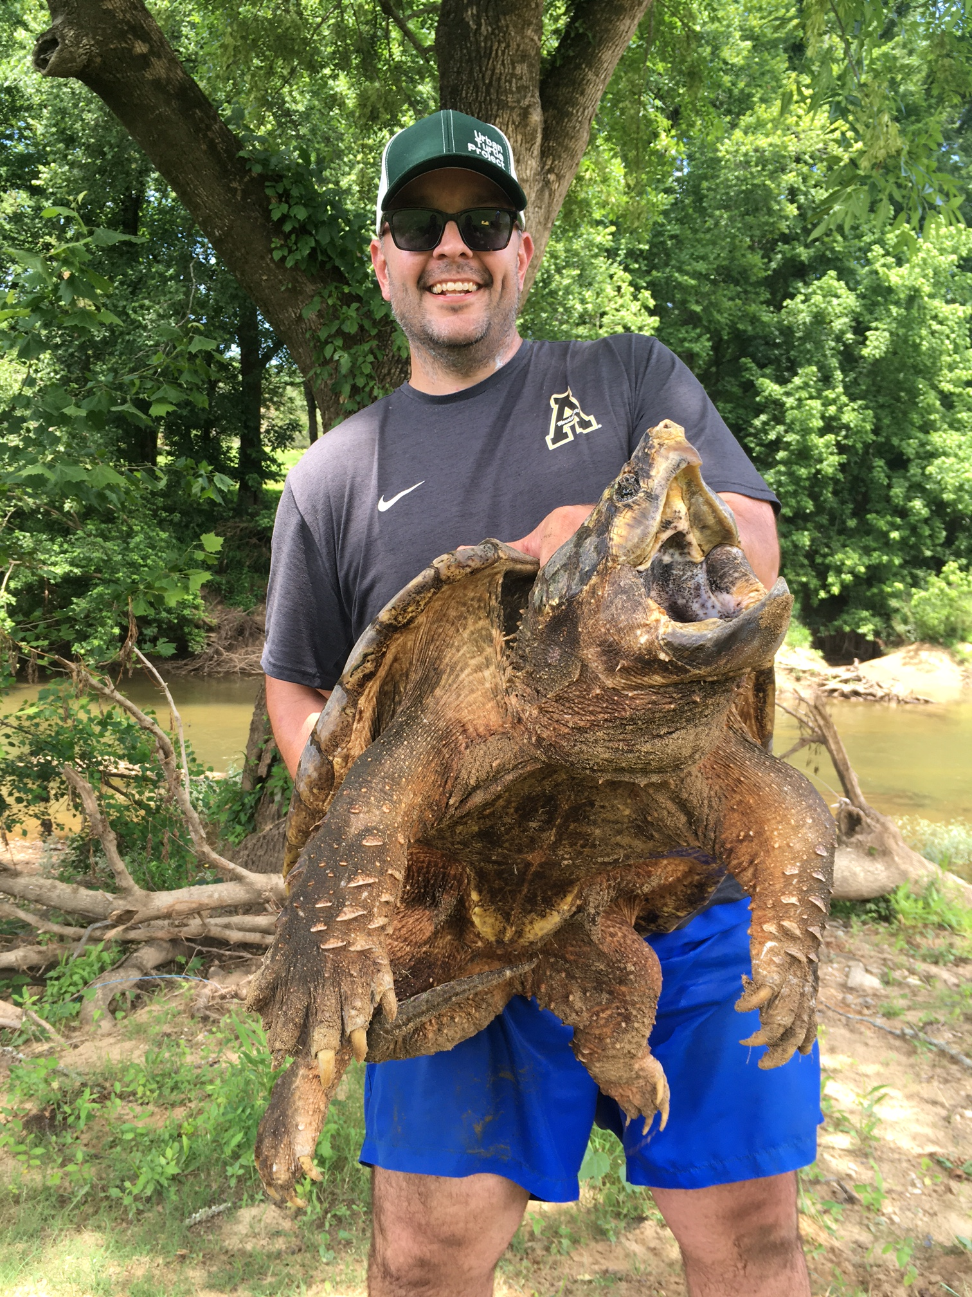
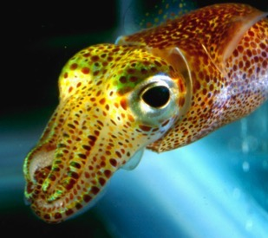


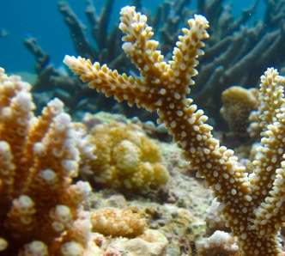

Notes:
Not only humans have microbiomes. Many organisms, from chickens to the crops we grow, are associated with a complex community of microbes.
References:
Ley, R. E., Hamady, M., Lozupone, C., Turnbaugh, P. J., Ramey, R. R., Bircher, J. S., et al. (2008). Evolution of Mammals and Their Gut Microbes. Science (80-. ). 320, 1647–1651. doi:10.1126/science.1155725.
McFall-Ngai, M., Hadfield, M. G., Bosch, T. C. G., Carey, H. V, Domazet-Lošo, T., Douglas, A. E., et al. (2013). Animals in a bacterial world, a new imperative for the life sciences. Proc. Natl. Acad. Sci. U. S. A. 110, 3229–3236. doi:10.1073/pnas.1218525110/-/DCSupplemental.
Weiss, B., and Aksoy, S. (2011). Microbiome influences on insect host vector competence. Trends Parasitol. 27, 514–522. doi:10.1016/j.pt.2011.05.001.
Christian, N., Whitaker, B. K., and Clay, K. (2015). Microbiomes: unifying animal and plant systems through the lens of community ecology theory. Front. Microbiol. 6, 1–15. doi:10.3389/fmicb.2015.00869.

Slide 7
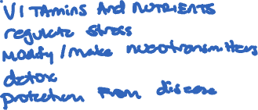
Why are host-associated microbes important
for their hosts?

Slide 8
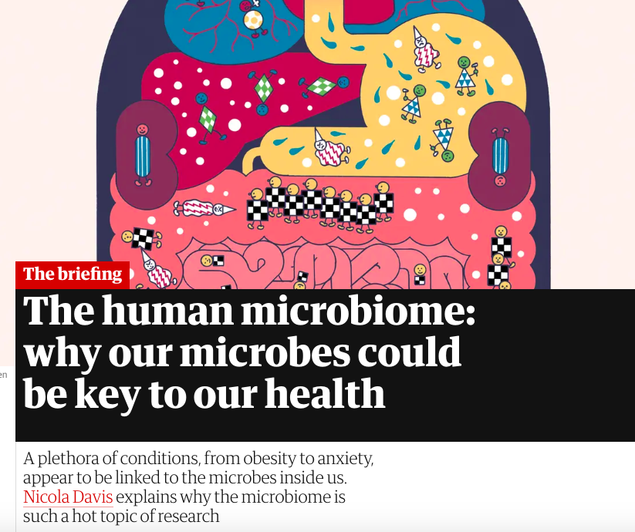
The Guardian
Notes:
For humans, this revolution has come with unprecedented interest in the roles that microbes may play in shaping our health and in how we interact with the environment. It has changed our willingness to take antibiotics without clear evidence of a harmful bacterial infection. It has shape research into many diseases, from obesity to anxiety.

Slide 9
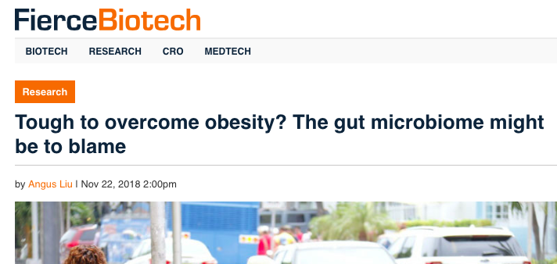

Slide 10
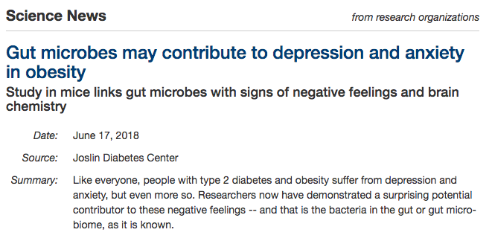

Slide 11
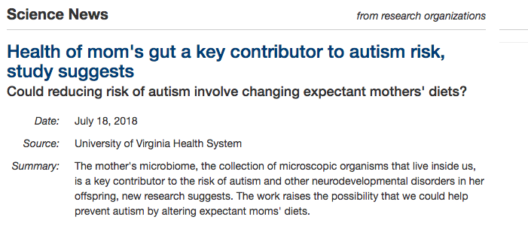

Slide 12
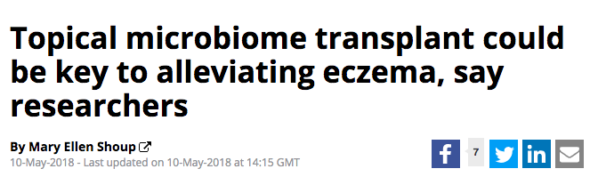

Slide 13
Notes:
Overall, there are many, many studies, some of which are high quality science and show a clear causal relationship between a microbe or microbes and diseases. In other cases, the research is only in its infancy and it likely not at the stage where it should shape practice. Despite this, more an more companies are exploiting interest in the microbiome to cell products, like these probiotics that cause $50 a bottle.

Slide 14
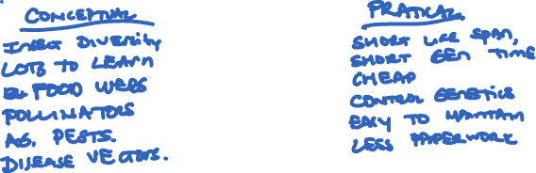
Why Study the Structure and Function
of Insect Microbiomes?
Why Insects?

Slide 15
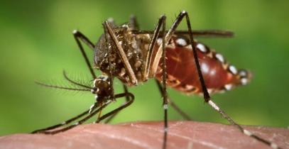
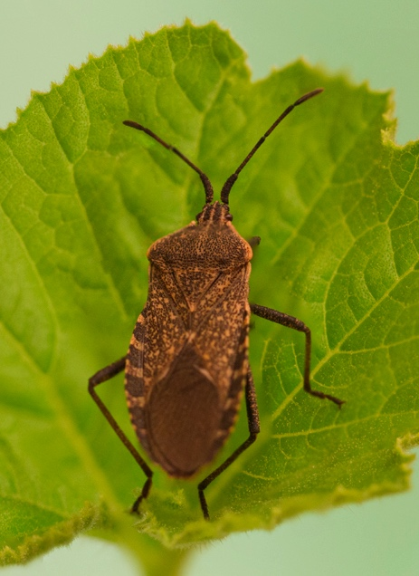
Insect Microbiomes

Slide 16
Insect Microbiomes

Slide 17
Data from World Health Organization
Notes:
Insects are important for a number of reasons. They pollinate our plants. They are food for many animals. The transmit disease. In fact, mosquitoes are considered the most deadly animals on earth because they transmit diseases to humans.

Slide 18
Wolbachia bacteria inside insect cell
Notes:
Because of their importance, we have studied many aspects of insect biology, including their association with bacteria, for centuries.
Many insect systems also serve as models for studying animal-microbe interactions more generally because insects tend to have simpler microbially communities inside of them than vertebrates, including humans.
Here is an image of one of the best-studied and most common insect-associated bacteria. The circles are Wolbachia bacteria that live inside insect cells. It has been estimated that more than 60% species of insects are associated with Wolbachia.

Slide 19
Notes:
The bacteria have been used to try and lessen the ability of mosquitoes to vector diseases. The first work involved introducing Wolbachia into mosquitoes that shortened their life long enough that they could pass on the bacteria to their children but short enough that viruses like dengue did not have enough time to develop.

Slide 20
Notes:
This shortened the mosquitoes lives because it lessened the ability of mosquitoes to feed.

Slide 21
Notes:
Then, it was found that other Wolbachia did something else. The made it harder to viruses like those that cause dengue and malaria to replicate inside the mosquitoes.

Slide 22
Notes:
The Bill and Melinda Gates Foundation is paying researchers to release mosquitoes carrying these Wolbachia into communities.
References:
http://www.eliminatedengue.com/program

Slide 23
Notes:
This is an example of one of these insect. This is Anasa tristis, the squash bug. Squash bugs are important agricultural pests. Like in the drawing, they have a large section of their gut with lots of folds in it. They call these sections crypts

Slide 24
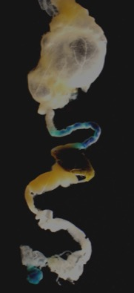
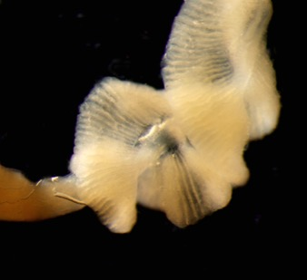

Notes:
This is an example of one of these insect. This is Anasa tristis, the squash bug. Squash bugs are important agricultural pests. Like in the drawing, they have a large section of their gut with lots of folds in it. They call these sections crypts

Slide 25



Types of Bacteria
Enterococcus
Lautropia
Unclassified
Wolbachia
Caballeronia
Earlier section of gut
relative abundance
Crypts
where
bacteria are
stored
relative abundance
Notes:
When researchers use sequencing technologies like being used as part of the bean beetle microbiome project, they find that the crypts mostly have bacteria in the genus Burkholderia, which are less common in other sections of the gut.

Slide 26
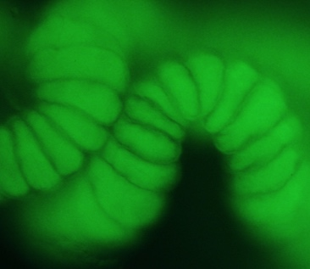
Crypt filled with GFP-labeled
Caballeronia
Notes:
These Burkholderia bacteria can be fluorescently labeled and fed back to the bugs. Here, you can see that the crypts are full of green fluorescent protein (GFP) labeled bacteria.

Slide 27
With Caballeronia
Without Caballeronia
Notes:
Association with Burkholderia has a number of benefits for the bugs. Here, we see that it increases survival over time relative to bugs not given Burkholderia.
References:
N.M. Gerardo, unpublished.

Slide 28
Notes:
Some of the best studied insect microbiomes are those associated with bees.

Slide 29
Notes:
Interest in bee associated microbes is in part because of declining bee populations in the United States.

Slide 30
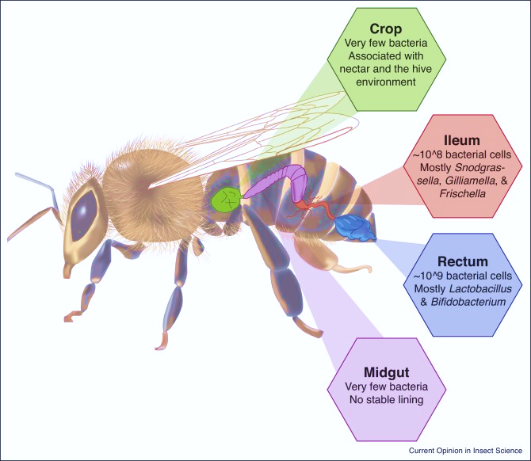
Raymann & Moran. 2018. Current Opinion in Insect Science
Notes:
As in humans, each part of the bee has a specialized bacterial community.

Slide 31
Zheng et al. 2018. Honey bee as models for gut microbiota research. Lab Animal.
Notes:
And, there are a lot of similarities between the impacts of microbes on bee physiology and the impacts of microbes on animal physiology, making them a model organism to study host-microbe interactions.
References
Zheng, H., Steele, M. I., Leonard, S. P., Motta, E. V. S., and Moran, N. A. (2018). Honey bees as models for gut microbiota research. Lab Anim. (NY). 47, 317–325. doi:10.1038/s41684-018-0173-x.
Raymann, K., and Moran, N. A. (2018). The role of the gut microbiome in health and disease of adult honey bee workers. Curr. Opin. Insect Sci. 26, 97–104. doi:10.1016/j.cois.2018.02.012.
References

Slide 32
What influences composition of the bee microbiome?
What traits does the bee microbiome impact?
Notes:
Some of the best studied insect microbiomes are those associated with bees.

Slide 33
What influences composition of the bee microbiome?
antibiotics, chemicals, climate, season, diet, sex, age
What traits does the bee microbiome impact?
Notes:
Some of the best studied insect microbiomes are those associated with bees.

Slide 34
What influences composition of the bee microbiome?
antibiotics, chemicals, climate, season, diet, sex, age
What traits does the bee microbiome impact?
Disease resistance, immune function, toxin processing, hormone regulation, growth & development
Notes:
Some of the best studied insect microbiomes are those associated with bees.

Slide 35
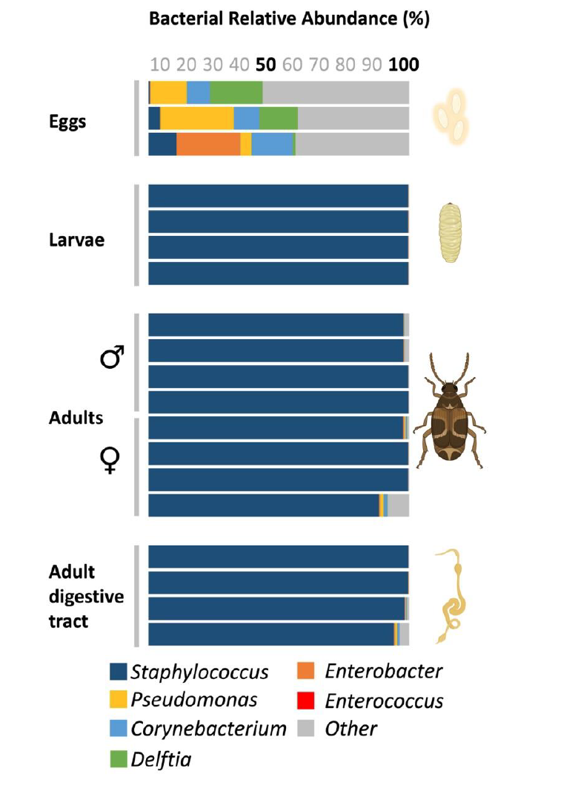
The Bean Beetle Microbiome

Slide 36
The Bean Beetle Microbiome

Slide 37
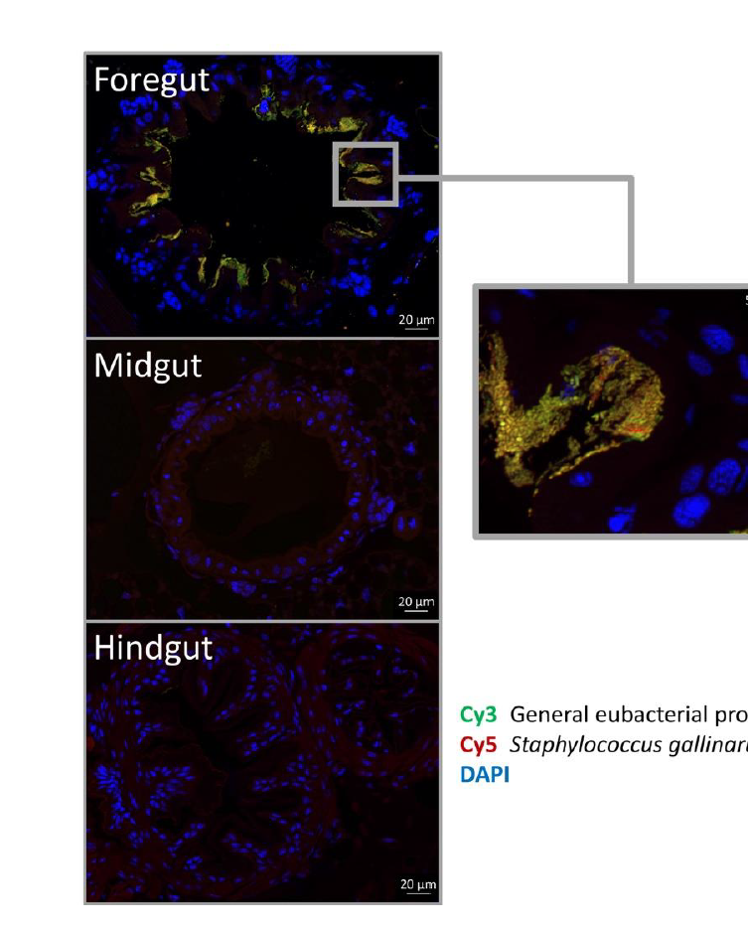
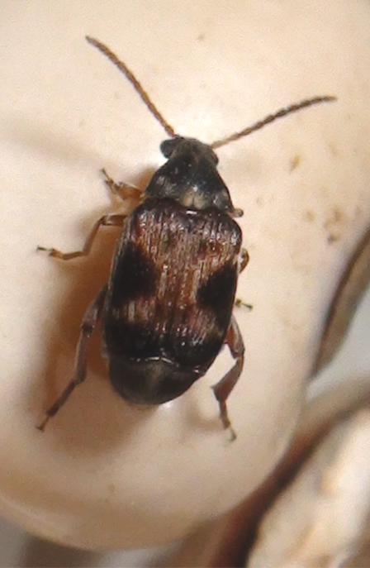
The Bean Beetle Microbiome
DNA:
Beetle
Staph-Specific
Most Bacteria

